Slide 1
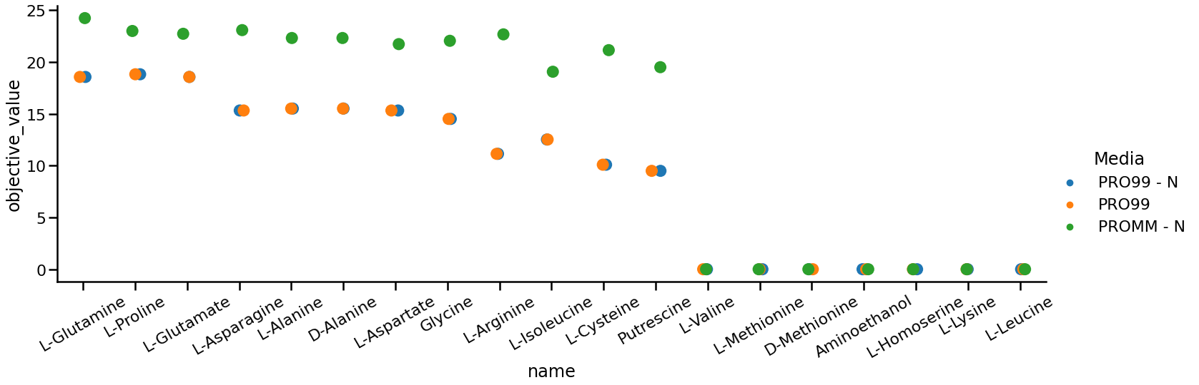
HOT1A3 Simulated growth
- Missing N and C source
- Missing C source
- Missing N source
Simulate using FBA
HOT1A3 model based on carveme gramneg + gapfilling on LB

Slide 2
Amino Acids

Slide 3
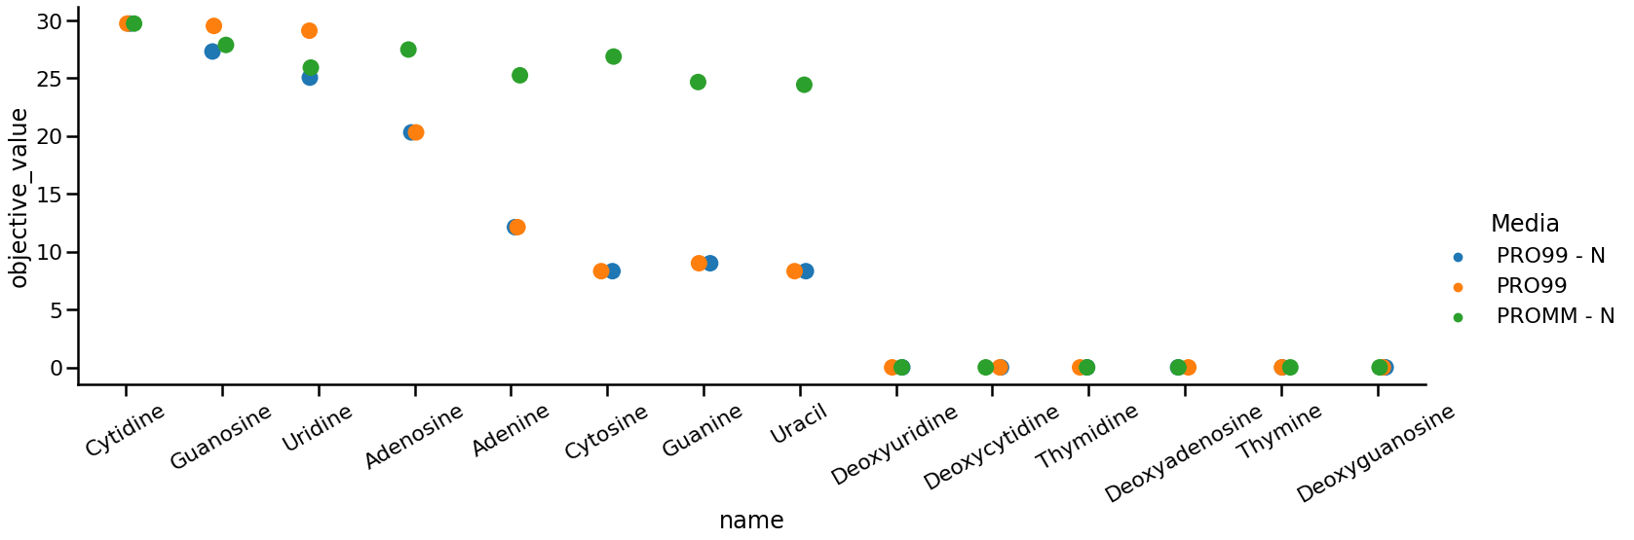
Nucleic acids

Slide 4
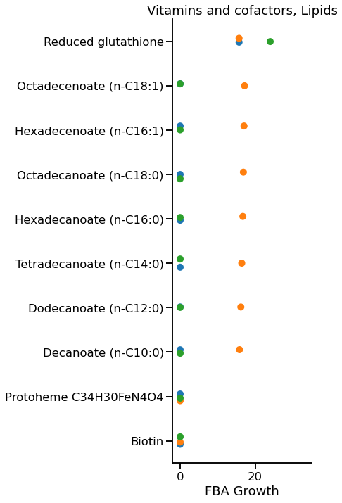
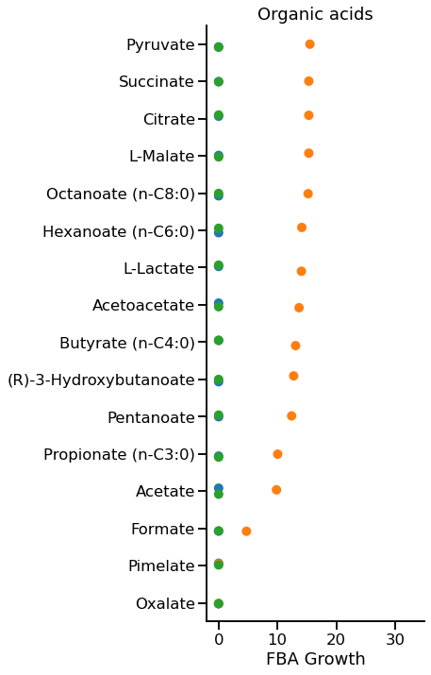
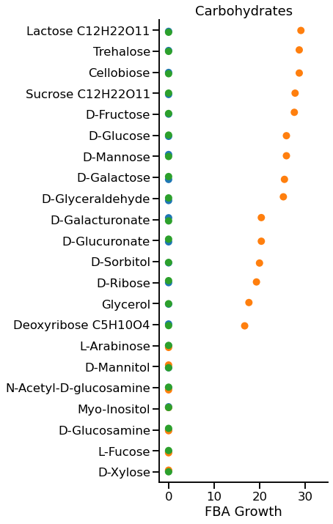

Slide 5
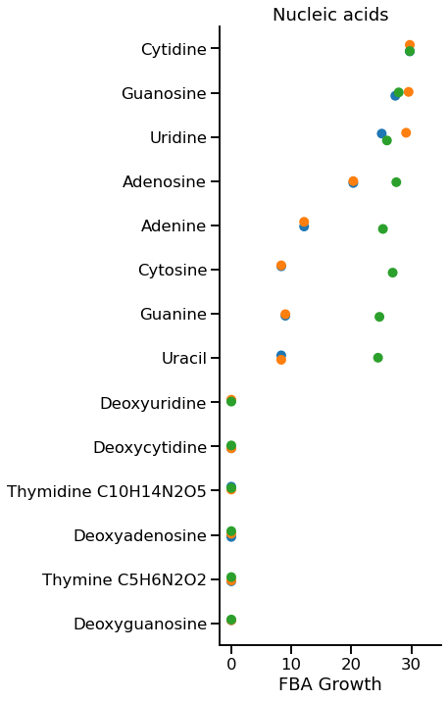
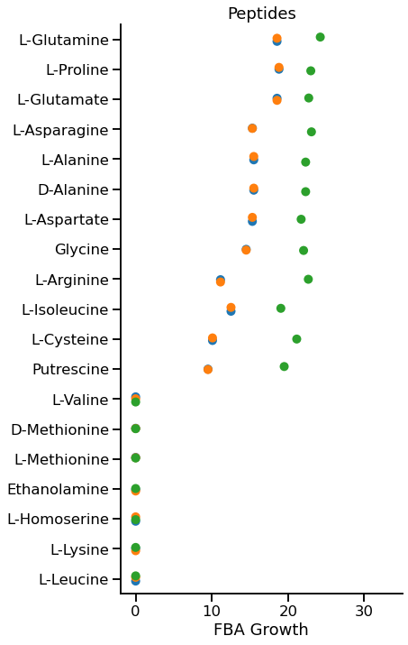

Slide 6
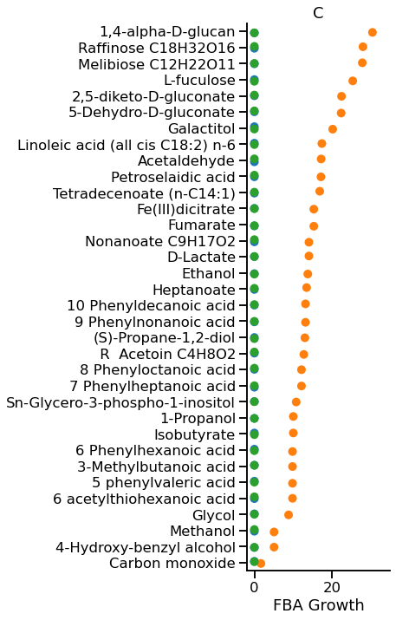
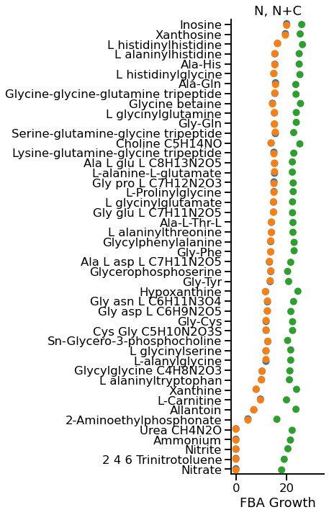
Others

Slide 7
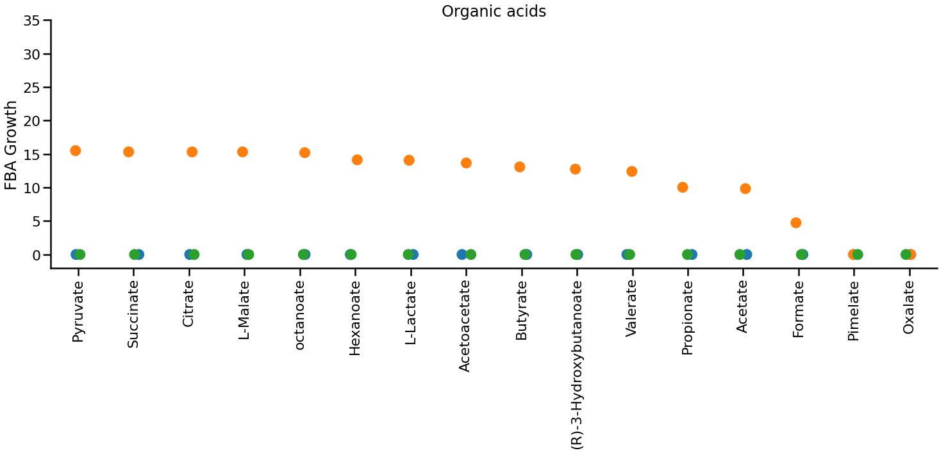
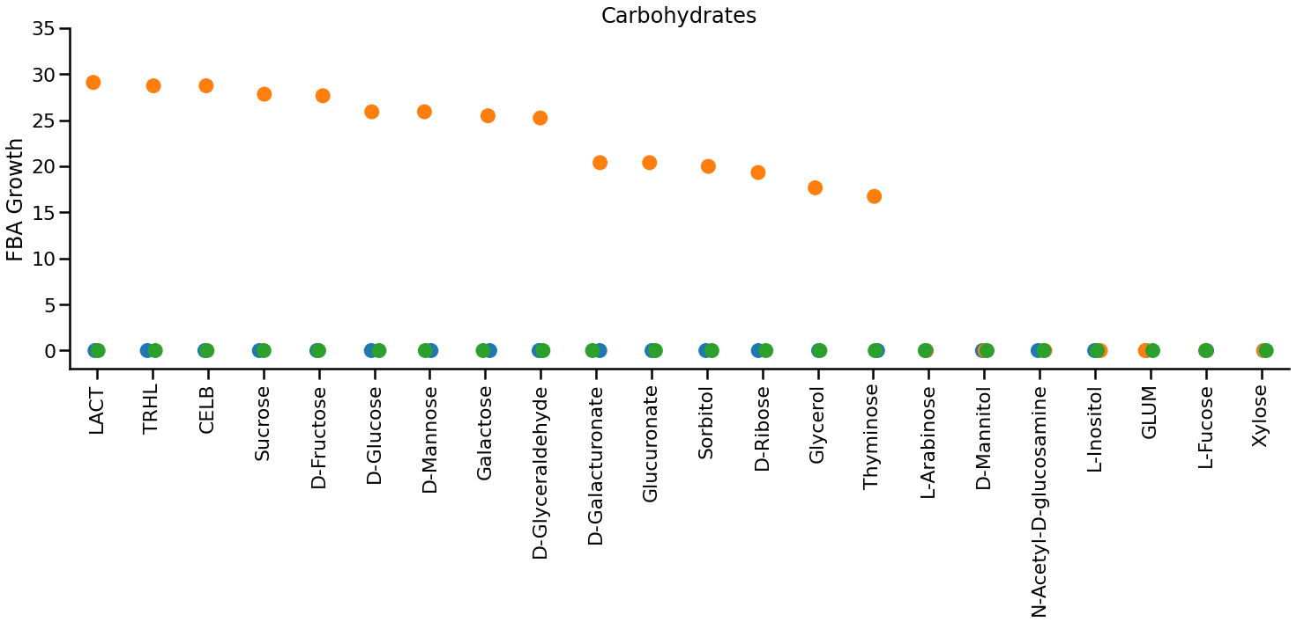
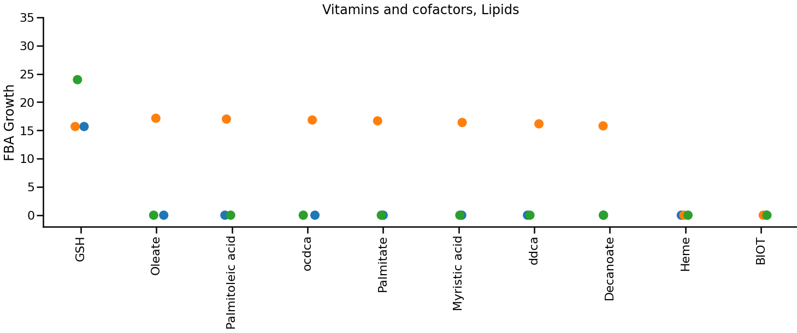

Slide 8
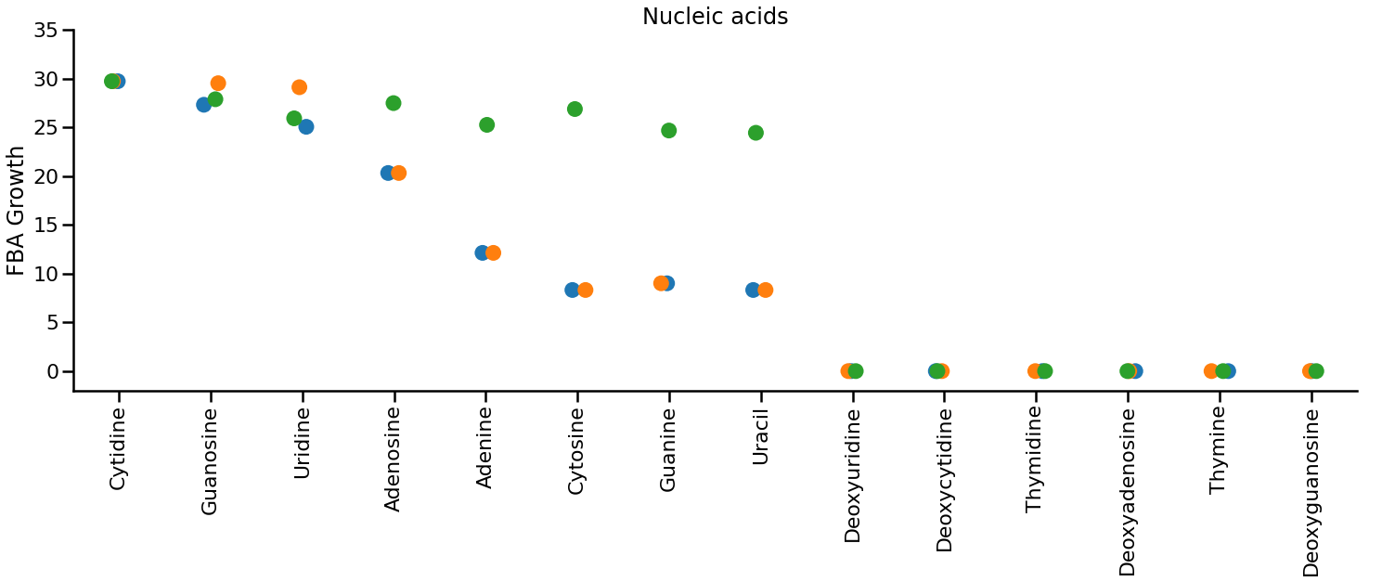
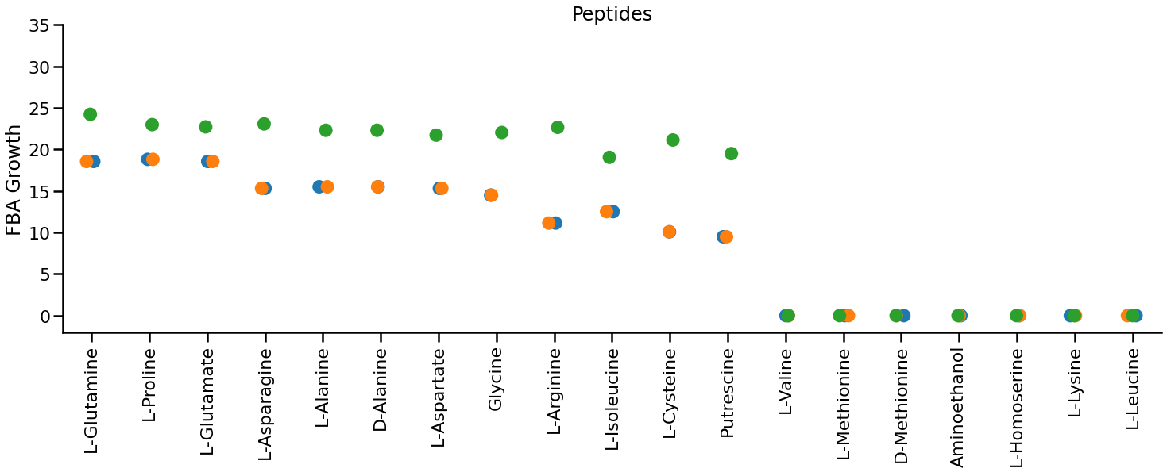

Slide 9
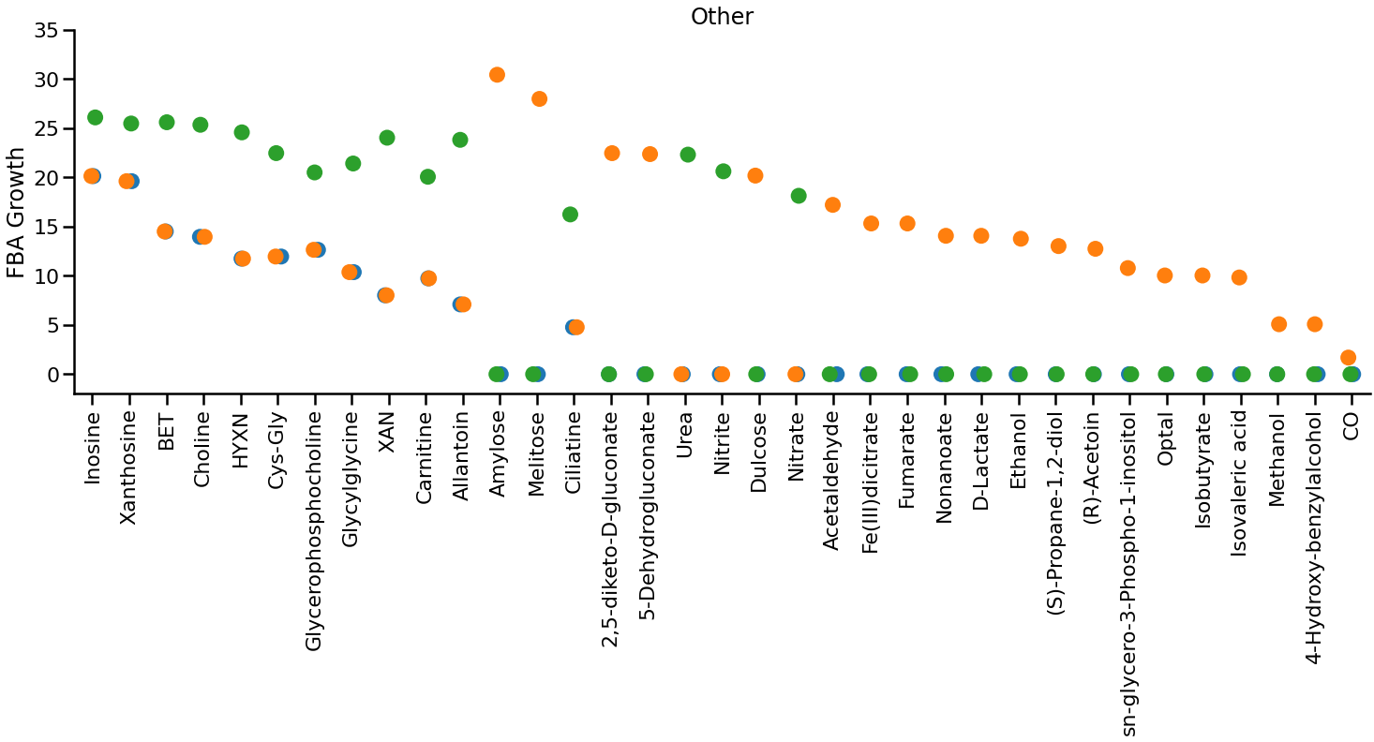

Slide 10
Pro99 media
Ca₂
Cl
CO₂
cobalt₂
Cu₂
Fe₂
H₂O₂
H₂O
H
K
Mg₂
Mn₂
Mobd
NH₄
O₂
P_{i}
Sel
So₄
Zn₂

Slide 11
